Slide 2
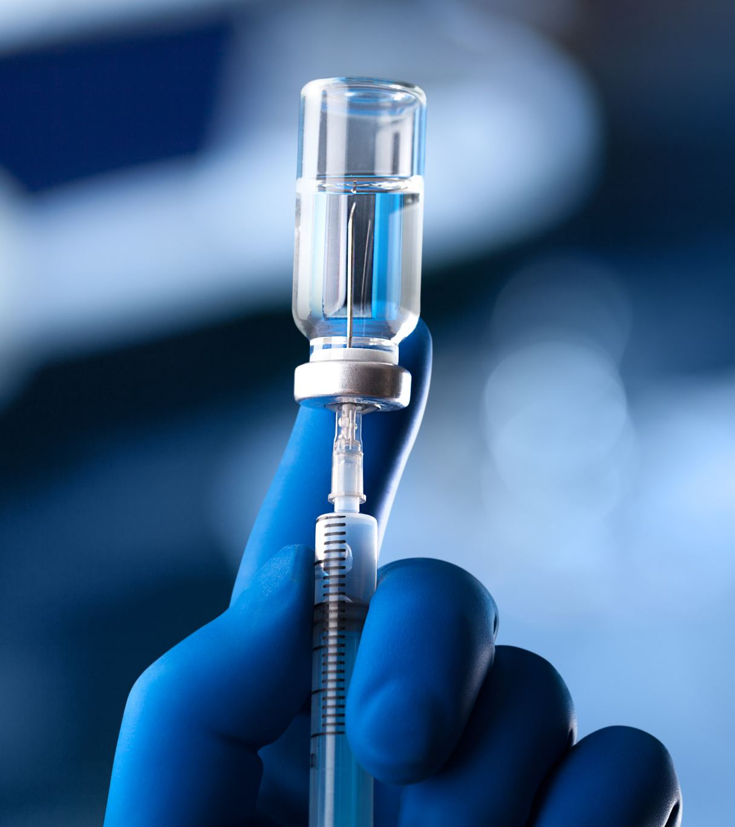
COVID-19 Vaccine Hesitancy: Breaking Barriers and Building Health
American Osteopathic association

Slide 3
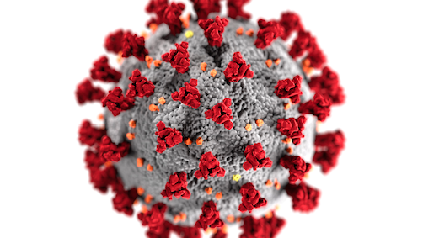
Landscape of COVID-19 Infections in the US
All Time Confirmed Cases: 88,381,589 (As of July 8, 2022)
Notes:
https://coronavirus.jhu.edu/region/united-states

Slide 4
National Vaccination Rates
Vaccination Reports:
Fully Vaccinated: 223,035,566
Doses Administered: 604,235,972
Percentage of Population Fully Vaccinated: 67.70%
Notes:
As of August 9, 2022. Data from Johns Hopkins University of Medicine Coronavirus Resource Center. (https://coronavirus.jhu.edu/region/united-states)

Slide 5
Vaccine Efficacy: Hospitalizations and Death Rates (As of Aug. 8, 2022)
Cumulative Hospitalizations: 50,016,769
Deaths: 1,034,020
Notes:
(https://coronavirus.jhu.edu/region/united-states)

Slide 6
State-Specific COVID-19 Trackers
Note: Include Your State Specific Data Here

Slide 7
Vaccinated vs. Unvaccinated
Length and time of symptoms
rural areas Vaccination rates reduced
Vaccine uptake amongst populations
Notes:
The landscape of the vaccinated and the unvaccinated has remained roughly static.
Therefore, it is important to understand which populations and locations have lower vaccine uptake so we may move the needle collectively on total vaccination rates worldwide.

Slide 8
Rural Area Vaccination Rate % Upon Receiving a First Primary Dose
 | URBAN | RURAL | DIFFERENCE
MEN | 73.2% | 55.7% | 17.5%
WOMEN | 77,6% | 61.4% | 16.2%
TOTAL | 75,4% | 58.5% | 16.9 %
Notes:
Except for Arizona, all states throughout the U.S. have higher urban vaccination adoption than rural.
Per the CDC, overall, from December 14, 2020–to January 31, 2022, rural counties have had lower first-dose vaccination coverage (58.5%) than did urban counties (75.4%) (DIFFERENCE of 16.9%).
Females and males had lower first-dose coverage in rural counties (61.4% and 55.7%, respectively) than in urban counties (77.6% and 73.2%, respectively)
A Difference of 16.2% in FEMALES and 17.5% in MEN (https://www.cdc.gov/mmwr/volumes/71/wr/mm7109a2.htm#T2_up)

Slide 9
Severity of COVID-19 Contraction
Unvaccinated:
Pre-existing conditions (Diabetes, High Blood Pressure, Heart Damage) are up to 9x more likely to suffer serious outcomes
ICU admission.
Death.
Kidney problems .
Lung failure . ( Ng et al, 2022)
Vaccinated (Receiving Primary Vaccination Series)
At-risk populations (Hispanics, non-Hispanic Black, non-Hispanic American Indian, Alaska Native) showed no greater risk after full vaccination.
Lower overall COVID-19-associated hospitalization & death rates.
Those at greatest risk for severe outcomes after contracting COVID-19: 65+ years, immunosuppressed, 1 of 6 underlying conditions, or 1 risk factor. (Yek et al, 2022)
Notes:
Consistent with studies that have shown that COVID-19 vaccination lowers the likelihood of COVID-19–associated hospitalization and death.
The risk for a severe COVID-19 outcome after primary vaccination was higher among persons aged ≥65 years, were immunosuppressed, or had one of six other underlying conditions; all persons with severe COVID-19 outcomes after primary vaccination had at least one risk factor. (Underlying medical conditions: age ≥65 years, diabetes mellitus, immunosuppression, chronic kidney disease, chronic liver disease, chronic neurologic disease, chronic cardiac disease, or chronic pulmonary disease).
Population-wide data have demonstrated that COVID-19 hospitalization and death are more frequent among Hispanic, non-Hispanic Black, and non-Hispanic American Indian or Alaska Native persons than among non-Hispanic White persons.
This might be explained by higher levels of SARS-CoV-2 exposure, reduced access to care, and higher rates of uncontrolled underlying conditions experienced by these populations.
However, this study did not find an association between race/ethnicity and severe COVID-19 outcomes after primary vaccination, suggesting that COVID-19 vaccines are important for helping to mitigate racial and ethnic disparities exacerbated by the COVID-19 pandemic. Yek et al. (https://www.cdc.gov/mmwr/volumes/71/wr/mm7101a4.htm#T1_down).
Unvaccinated individuals who contract COVID-19 when they have pre-existing diabetes, high blood pressure, or major heart damage, are up to 9 times more likely to suffer serious outcomes, including admission to the intensive care unit (ICU), death, kidney problems and lung failure, according to combined evidence from 110 previous COVID-19 studies.(Ng et al, 2022) (https://www.frontiersin.org/articles/10.3389/fcvm.2022.871151/full?&utm_source=Email_to_authors_&utm_medium=Email&utm_content=T1_11.5e1_author&utm_campaign=Email_publication&field=&journalName=Frontiers_in_Cardiovascular_Medicine&id=871151)

Slide 10
Vaccine Uptake Amongst Populations
Notes:
A study by Troiano and Nardi in December of 2020.
Studies included in review were based around the world: USA, France, Israel, Italy, Malta, Hong Kong, Canada, Japan, Spain, and Switzerland
Lower Vaccine Acceptance amongst African American participants, women, younger, unemployed, high religiosity, lower income, high political partnership (Troiano & Nardi, 2021)(Glassman, 2022).

Slide 11
A Review of COVID-19 Vaccination Types
Mrna: Pfizer and Moderna
Viral Vector: Johnson & Johnson
Adjuvanted: Noravax
Notes:
mRNA: Messenger RNA (mRNA) vaccines teach our cells how to make a protein that will trigger an immune response inside our bodies.
(https://www.cdc.gov/coronavirus/2019-ncov/vaccines/different-vaccines/mRNA.html).
(https://www.cdc.gov/mmwr/volumes/71/wr/mm7101a4.htm#T1_down)
Viral Vector: Viral vector vaccines use a modified version of a virus that is different from the virus being targeted to deliver important instructions to our cells. The modified version of the virus is called a vector virus.
(https://www.cdc.gov/coronavirus/2019-ncov/vaccines/different-vaccines/viralvector.html#:~:text=Viral%20vector%20vaccines%20use%20a,is%20called%20a%20ve)

Slide 12
Novavax COVID-19, Adjuvanted Vaccine
Manufacturer: Novavax, Inc.
Number of Shots: 2 doses in the primary series, given 3–8 weeks apart.
People who are moderately or severely immunocompromised should also receive 2 doses, given 3 weeks apart (a 3rd primary dose is not currently authorized).
Booster Shot: Novavax COVID-19 vaccine is not authorized for use as a booster dose.
Type of Vaccine: Protein subunit.
How Given: Shot in the muscle of the upper arm.
Source: CDC
Notes:
The Novavax COVID-19 vaccine includes harmless pieces (proteins) of the virus that causes COVID-19. These pieces are often called spike proteins. After vaccination, the body creates an immune response to these protein pieces which helps to protect you from contracting COVID-19 in the future. After the body produces an immune response, it discards all the vaccine ingredients. The process of discarding any substance that cells no longer need is a part of normal body functioning.

Slide 13
COVID-19 vaccines for infants & children: 6 months to under 5 years
On June 17, 2022, the U.S. FDA authorized the emergency use of COVID-19 Vaccines from Pfizer BioNTech and Moderna for children starting at age 6 months.
On June 18, 2022, the CDC’s Advisory Committee on Immunization Practices (ACIP) recommended the use of these COVID-19 vaccines for children starting at age 6 months. Together, their support authorizes widespread administration of the vaccine.
The COVID-19 vaccines for young children are safe and effective.
Notes:
Young children are at risk for contracting COVID-19, and some can get seriously ill. Even if a child doesn’t get severely ill, they could face long-term health consequences or pass the virus to others. The best way to protect children against COVID-19—in daycare, school, sports, and with their friends—is by getting them vaccinated.
Like other pediatric vaccines, these vaccines were thoroughly tested and then reviewed by the FDA and CDC before these agencies authorized and recommended them for wide use. The vaccines are available at no cost and regardless of citizenship or insurance status.

Slide 14
Oral Medications
Meta-analysis by Wen et al was conducted upon the use of three new oral antivirals to evaluate the improvement in mortality or hospitalization rates and adverse events among COVID-19 patients.
Results showed the novel oral antivirals were effective in reducing mortality and hospitalization rates with COVID-19 by approximately 67%.
Results: These antiviral drugs have shown good therapeutic effects and did not increase the occurrence of adverse events, thereby demonstrating good overarching safety. However, there is no simple oral antiviral drug for COVID-19 patients.
Notes:
Wen W, Chen C, Tang J, Wang C, Zhou M, Cheng Y, Zhou X, Wu Q, Zhang X, Feng Z, Wang M, Mao Q. Efficacy and safety of three new oral antiviral treatment (molnupiravir, fluvoxamine and Paxlovid) for COVID-19：a meta-analysis. Ann Med. 2022 Dec;54(1):516-523. doi: 10.1080/07853890.2022.2034936. PMID: 35118917; PMCID: PMC8820829.

Slide 15
Notes:
The University of Liverpool has provided an online drug interaction checker to assure patients will not experience contraindications with prior prescription drug usage and COVID-19 medications.
This may be especially helpful for use of COVID-19 antiviral medications.

Slide 16
Who Should Get Vaccinated?

Slide 17
COVID-19 Vaccine Contraindications
History of a severe allergic reaction (e.g., anaphylaxis) after a previous dose or to a component of the COVID-19 vaccine.
Known diagnosed allergy to a component of the vaccine.
History of thrombosis with thrombocytopenia syndrome (TTS) following receipt of a previous Janssen COVID-19 Vaccine (or other COVID-19 vaccines not currently authorized in the United States that are based on adenovirus vectors).
Notes:
Additionally, people with a history of an episode of an immune-mediated syndrome characterized by thrombosis and thrombocytopenia, such as spontaneous or classic HIT (Heparin‐induced thrombocytopenia), should not receive Janssen COVID-19 Vaccine.
These patients should receive an mRNA COVID-19 vaccine
CDC : (https://www.cdc.gov/vaccines/covid-19/info-by-product/pfizer/bioNTech-purple-cap-12-and-over.html)

Slide 18
COVID-19 Vaccine Precautions
History of an immediate allergic reaction† to any non-COVID-19 vaccine or injectable therapy (i.e., intramuscular, intravenous, or subcutaneous vaccines or therapies [excluding subcutaneous immunotherapy for allergies, i.e., “allergy shots”)
This includes non-COVID-19 vaccines or injectable therapies with multiple components, and the component(s) that elicited the reaction is unknown.
History of an immediate (within 4 hours after vaccination) non-severe, allergic reaction after a dose of one type of COVID-19 vaccine (i.e., mRNA or Janssen) have a precaution to the same type of COIVD-19 vaccine
Contraindication to one type of COVID-19 vaccine (mRNA) is a precaution to other types of COVID-19 vaccines (Janssen)±
Moderate to severe acute illness with or without fever
For mRNA COVID-19 vaccines, history of myocarditis or pericarditis after a dose of mRNA COVID-19 vaccine
For Janssen COVID-19 Vaccine, a history of GBS
People who develop GBS within 6 weeks after receipt of the Janssen COVID-19 Vaccine should not receive another dose of the Janssen COVID-19 Vaccine. These people should receive an mRNA COVID-19 vaccine.
Notes:
https://www.cdc.gov/vaccines/covid-19/info-by-product/pfizer/bioNTech-purple-cap-12-and-over.html

Slide 19
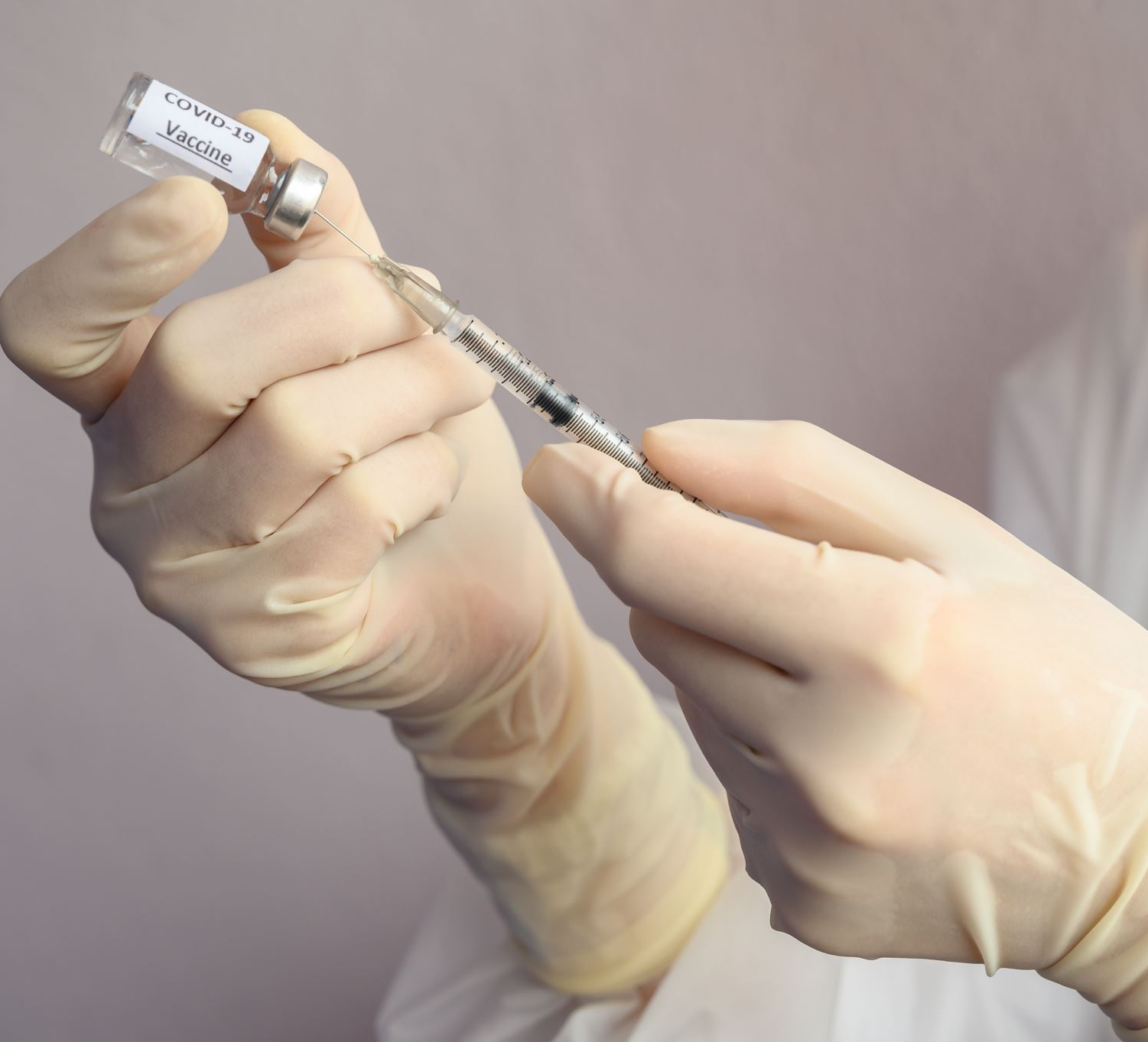
Potential Vaccine Side Effects

Slide 20
Severe Reactions After Vaccination Are Rare
Anaphylaxis (5: 1 million)
Thrombosis with Thrombocytopenia (4: 1 million)
Guillain-Barré (J&J/Janssen COVID-19 Vaccine)
Myocarditis and Pericarditis
Deaths (.0025%)
Notes:
https://www.cdc.gov/coronavirus/2019-ncov/vaccines/safety/adverse-events.html

Slide 21
Common Side Effects Post-Vaccination
INJECTION SITE SYMPTOMS
Pain
Redness
Swelling
BODILY SYMPTOMS
Tiredness
Headache
Muscle pain
Chills
Fever
Nausea
Notes:
Adverse effects that could cause a long-term health problem are extremely unusual following any vaccination, including COVID-19 vaccination. If adverse effects occur, they generally happen within six weeks of receiving a vaccine dose.
Side effects may affect ability to do daily activities, but they should go away in a few days.
Side effects after the second shot or booster may be more intense than the ones experienced after the first shot. These side effects are normal signs that the body is building protection and should go away within a few days.
In most cases, discomfort from fever or pain is normal. Contact your doctor or healthcare provider: (1) If the redness or tenderness where you got the shot increases after 24 hours (2) If your side effects are worrying you or do not seem to be going away after a few days.
(https://www.cdc.gov/coronavirus/2019-ncov/vaccines/safety/adverse-events.html).

Slide 22
Antibody Testing
Generally, should not be used to diagnose a current infection.
Not currently recommended to assess immunity following vaccination.
Have varying degrees of accuracy.
Minimize false-positive results by choosing a test with HIGH SPECIFICITY.
With a POSITIVE antibody test, one can continue normal activities but should take steps to protect self and others, including vaccination.
Notes:
https://www.cdc.gov/coronavirus/2019-ncov/lab/resources/antibody-tests.html

Slide 23
Vaccination: To Be or Not to Be?
Ask the patient to do their research to support them in being an active participant in their own health.
Patient questions are important and getting the right answers from reliable sources can add to their peace of mind.
Having discussion with their trusted osteopathic physician and people they know who have been vaccinated can provide learning opportunities.
Becoming educated about the COVID-19 vaccine, patients can make the most informed decision about getting vaccinated.
Notes:
https://www.hopkinsmedicine.org/health/conditions-and-diseases/coronavirus/covid19-vaccine-hesitancy-12-things-you

Slide 24
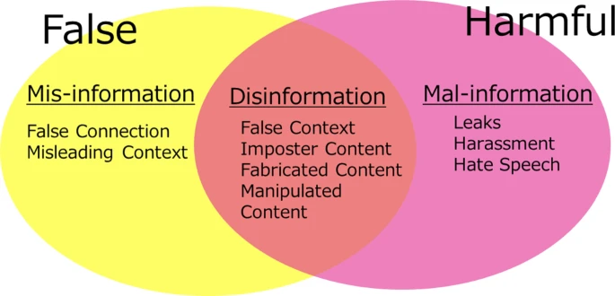
Defining Inaccurate Sources of Information
Notes:
Misinformation, while erroneous, is not intended to cause harm, unlike disinformation or mal-information.
Misinformation can be addressed by the physician to improve accurate vaccination facts and mitigate the dissemination of erroneous data that may impact others. (https://link.springer.com/article/10.1365/s43439-020-00010-7)

Slide 25
Myths Around COVID-19 Vaccine
COMMON MYTHS around the COVID-19 Vaccine
The ingredients in COVID-19 vaccines are dangerous.
COVID-19 vaccines cause variants.
All events reported to the Vaccine Adverse Event Reporting System (VAERS) are caused by vaccination.
The natural immunity from being sick with COVID-19 is better than the immunity received from COVID-19 vaccination.
The mRNA vaccine is not considered a vaccine.
COVID-19 vaccines contain microchips.
Receiving a COVID-19 vaccine can make you magnetic.
COVID-19 vaccines can alter my DNA.
Notes:
The above myths are common examples of misinformation circulating in the public. https://www.cdc.gov/coronavirus/2019-ncov/vaccines/facts.html

Slide 26
Vaccine Hesitancy: Categorization
Circumspection (Concerns/Unknowns)
Confidence (Reduction in confidence in multiple regards)
Complacency (Uninspired to take action)
Notes:
Liu & Li, 2021. Hesitancy is not a linear or superficial phenomenon. It’s a highly complex decision-making process involving social, emotional, political, cognitive, and cultural factors (Glassman, 2022).
In a study by Latkin et al titled “COVID-19 vaccine intentions in the United States, a social-ecological framework”: this study suggests several avenues for COVID-19 vaccine promotion campaigns, including social network diffusion strategies and cross-partisan messaging, to promote vaccine trust. The racial and gender differences in vaccine intentions also suggest the need to tailor campaigns based on gender and race. (Latkin et al: https://www.ncbi.nlm.nih.gov/pmc/articles/PMC7945864/)

Slide 27
Risk Perception: the potential for a negative future outcome (World Health Organization)
Individuals perceive risk according to how probable they believe it is that a specific type of event will take place (probability), and how concerned they are with the consequences of such an event (severity).
Risk can also be a feeling. Feelings about risk have a stronger impact on behavior than knowledge about risk.
In absence of disease, fear of disease has been replaced by fear of vaccines for some people.
Notes:
Both disease and vaccination may be associated with risk.
A person may think that the disease is likely and/or severe, and he or she may feel that vaccine side-effects are likely and/or severe.
The general rule that applies is: • if people perceive high levels of risk of disease, they will be more likely to vaccinate; whereas • if people perceive high levels of risk of vaccination, they will become less likely to vaccinate.
Cite: World Health Organization. Vaccination and Trust: How concerns arise and the role of communication in mitigating crises https://www.euro.who.int/__data/assets/pdf_file/0004/329647/Vaccines-and-trust.PDF

Slide 28
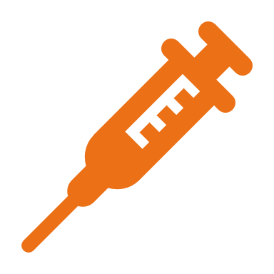
The Power of Relationship in Vaccine Hesitancy and Patient Behavior Change: Partnering with Patients & Evidence-Based Science to Inspire Change.

Slide 29
Transtheoretical Stages of Change
Image: NIH
Notes:
Precontemplation: Behavior is unrecognized, and the patient may be in denial without plans to change. May have given upon previous change attempts.
Contemplation: The patient may recognize behavior & mixed emotions. They may see the reason for change but remain reluctant; therefore, no behavioral change occurs.
Preparation/Action: May decide to change, think of ways to change, and take action steps. Initiation of change may occur but problem behavior as well.
Maintenance: Changes are maintained but challenges may remain.
Relapse: This May occur at any stage and patients may return to their behavior.
Image credit: https://www.ncbi.nlm.nih.gov/books/NBK138719/figure/part1_ch1.f2/

Slide 30
Social Learning Theory: Understanding Vaccine Hesitancy
Personal Factors:
Knowledge
Expectations
Attitudes
1
Behavioral Factors:
Skills
Practice
Self-Efficacy
2
Environmental Factors:
Social Norms
Access
Influence on Others
3
Notes:
To Be (Vaccinated) or Not to Be: The Effect of Media Exposure, Institutional Trust, and Incentives on Attitudes toward COVID-19 Vaccination
(https://pubmed.ncbi.nlm.nih.gov/34948501/)
The relationship between exposure to information about the vaccine and attitude toward vaccination is not direct as was expected from social learning theory. The effect of exposure to information about COVID-19 vaccination on attitude formation was rather indirect and mediated by individuals’ trust of the players, such as trust in governmental institutions and media (mass media and social media).
Second, the effect of trust on attitude is source dependent.
Third, the use of incentives, such as green pass documenting vaccination, monetary incentives, or vaccine accessibility (available in safe, familiar, and convenient places) can reduce the institutional mistrust effect and enhance vaccination attitude and actual vaccination.
Study: Individual and social determinants of COVID-19 vaccine uptake.
Outcome variables of interest were the likelihood of vaccinating self and the likelihood of vaccinating people under one’s care (such as children) measuring behavioral intentions.
The results indicated that 68% agreed to get the vaccine for themselves and 65% for people under their care, respectively.
Risk perceptions (severity of and susceptibility to COVID-19) were significantly associated with vaccine uptake.
People who relied on “conservative” news outlets, Republicans, and who had low confidence in scientists are least likely to vaccinate themselves or children.
Non-Hispanic Blacks and those with least schooling were also less likely to receive COVID-19 vaccine for themselves or people in their care
(https://bmcpublichealth.biomedcentral.com/articles/10.1186/s12889-021-10862-1)

Slide 31
The Trusted Physician-Patient Relationship Sets the Stage for Health & Wellness The Physician’s Role as an Invested Participant in Patients’ Health Outcomes
Notes:
In life, there is a continuum of independence and interdependence.
Research is showing the scientific reality of interconnectedness in the lives of ourselves, others, and the world.
The energy of the heart links us to each other.
Through a measurable electromagnetic energy field emitted by the heart, humans are connected to all living things and each other. (www.heartmath.org/gci).
Our interactions can shift the internal state of another from one of incoherence to one of inner balance thus facilitating the healing process.

Slide 32
Practicing Presence and Pausing During Patient Interactions= A Learned Skillset
Notes:
Embracing an attitude of empathy and collaboration.
A JAMA study showed that when physicians stop all actions and became still during a patient visit, the patient provided important information to their care that they had reluctant to share.
Therefore, when the physician directly focuses and listens to the patient by TAKING TIME TO STOP AND ENGAGE improved communication and insight results. (RAKEL) (https://pubmed.ncbi.nlm.nih.gov/10478689/)

Slide 33
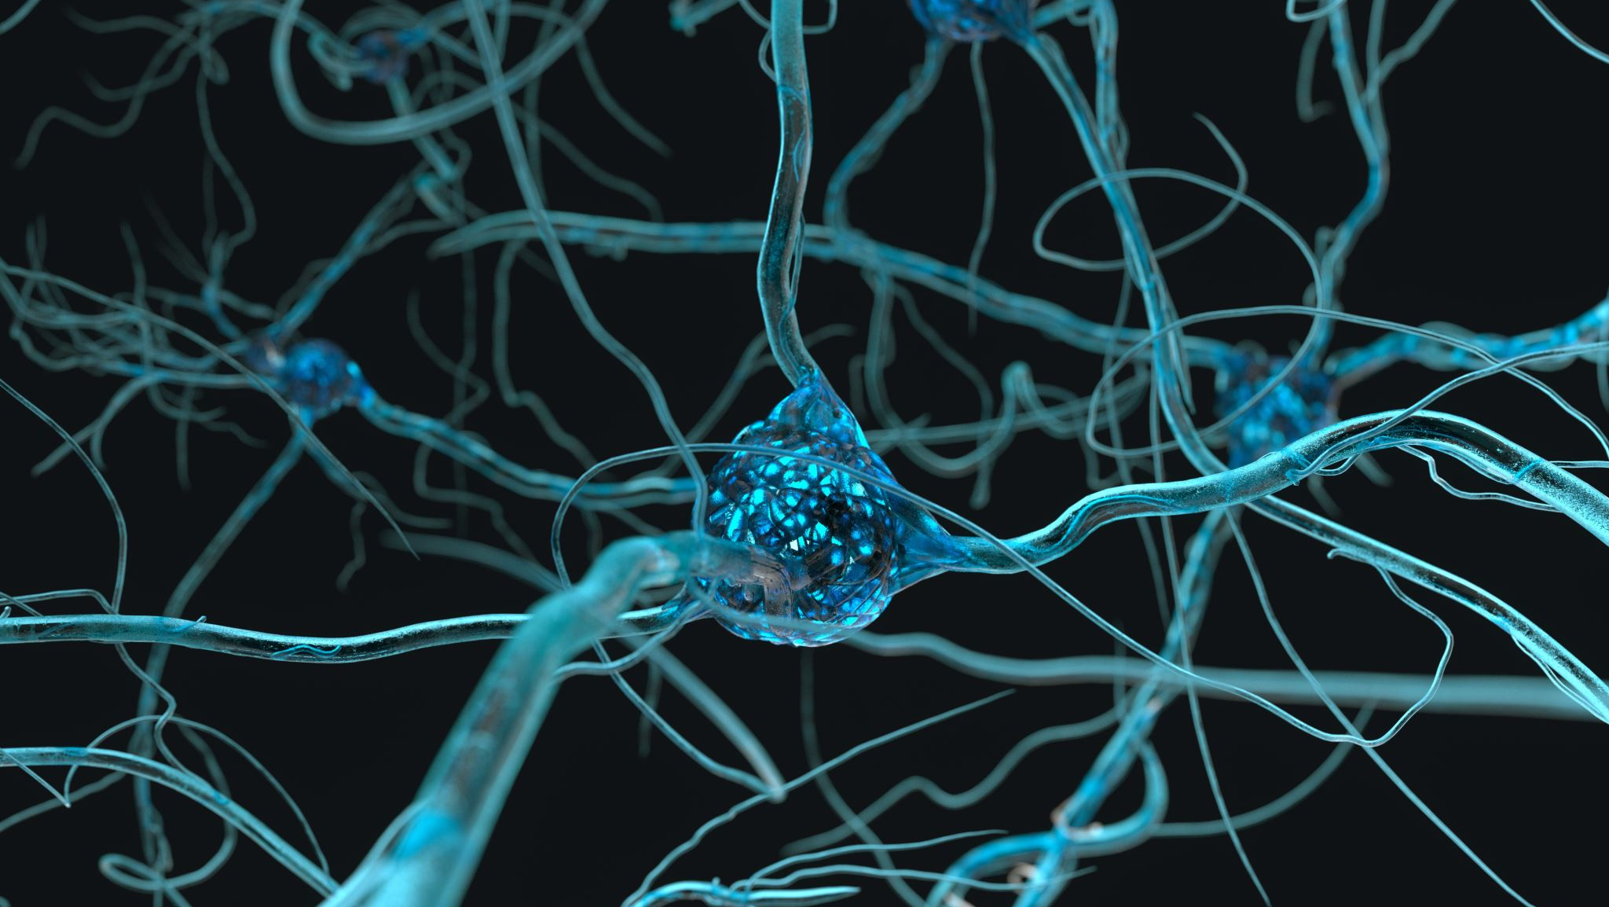
Mirror Neurons & Nonverbal Attunement: A Model of Empathic Communication
Notes:
As social creatures, we read facial expressions and other nonverbal cues to feel safe and understood.
Mirror neurons play a role in social interaction. When one mirrors the facial expressions of another they feel understood.
In a study titled “The busy social brain: evidence for automaticity and control in the Nervous System supporting social cognition and action understanding”, results support a dual-process model of the brain systems underlying action understanding and social cognition; the mirror neuron system supports automatic behavior identification, and the mentalizing system supports controlled social causal attribution. (Spunt and Lieberman) (https://pubmed.ncbi.nlm.nih.gov/23221019/).
In a JAMA-published study titled “A model of empathic communication in the medical interview”, the basic empathic skillset recognize when emotions may be present but not directly expressed, inviting exploration of these unexpressed feelings, and effectively acknowledging these feelings so the patient feels understood.
The lack of acknowledgment by physicians of both direct and indirect expressions of affect was found to pose a threat to the patient-physician relationship. (https://pubmed.ncbi.nlm.nih.gov/9039890/)

Slide 34
Key Element of Trusting Relationships: How Physicians Make the Patient Feel
Notes:
There is a silent process that occurs in engagement with others.
A physician in heart coherence can aid in attuning a patient’s physiology into coherence, a state of where the immune, hormonal, and nervous systems function in optimal energetic coordination.
This is also a state when the mind, heart, and emotions are operating in a synchronized and balanced fashion.
This is one reason why we remember how others make us feel.

Slide 35
Trust= (Intimacy x Physician Competency)/ Condition Risk (Napier Group, Pennsylvia)
Notes:
Using the POWER of connection to promote the healing response.
The greater the conditional risk, the more important intimacy and competency become.
When a patient has a greater risk for COVID-19 complications, trust through connection and competency can promote safe vaccination.
David Rakel, MD ("The Compassionate Connection: The Healing Power of Empathy and Mindful Listening") and Napier Group.

Slide 36
Asking Permission to Talk about COVID-19 Vaccination
Notes:
While vaccine hesitancy is a subject of much concern related to COVID-19, it is advantageous to ask the patient’s permission to discuss the topic.
This provides an environmental condition where the patient feels respected and in control.
Persuasion does not equate to a desire to engage in this subject matter.
Therefore, asking to engage in COVID-19 discussion sets the stage for collaboration, care, cooperation, support, and communication. If the patient says no, respect that.
Option 1: Move on and say, “I respect that, and because I care about your overall health, maybe we could discuss the vaccines at a future time.”
Option 2: Based on the patient’s demonstrated emotions and your assessment of their worldview and values, you could spend several minutes curiously exploring why the patient doesn’t want to talk about it. The goal is to understand, not to change their mind. Remember: These conversations may take time and continue over multiple visits.
If the patient says yes to talking about the vaccines, move to Motivational Interviewing Techniques.
If the patient asks a question about COVID-19 vaccine safety, vaccine risks, or their health or mental health, respond within the boundaries of your understanding/knowledge, the scope of practice, and ethics. (https://www.cdc.gov/vaccines/covid-19/hcp/engaging-patients.html).

Slide 37
Understanding the mind of the Patient: Habit, Beliefs, and Unconscious Patterns
Notes:
Stepping into the mind of a patient: When trying to make changes in life, having good intentions is often not enough because they can get overridden by powerful motivations and environmental triggers that influence our actions (Bargh, Greater Good Magazine)
Habits are a set of repeated beliefs that have become automatic.
To break out of a habit, we first must identify the underlying thought, and choose a new belief with a greater intention than the original.
Breaking a habit can be difficult if one is not aware of the underlying thought process.
When we meet others in the present moment, it can be an opportunity for the patient to identify, accept and adopt a new belief.
This may be extremely useful, regarding COVID-19 misinformation.
Approximately 95% of what we do each day is a set of repeated learned programmed subconscious behaviors; therefore, the remaining 5% is conscious awareness/activity using the prefrontal cortex (thinking mind).
Changes happen in the present moment and not in the state of reflection in the past or projection in the future. (Dispenza)
Note: Include full citations.

Slide 38
Motivational Interviewing: Cultivating a Safe, Empathic Environment to Understand Patients’ Salient Health Goals
Physician needs to set aside their own biases about the patient.
A physician’s intention can change their perception of the patient-> TRIGGER neuropeptide alteration resulting in neuroplastic changes and epigenetic influences.
Where you put your focus is where your energy gets directed. Seeing the BIG picture.
Notes:
The physician must know thy self to mitigate implicit biases in their perception, interaction, and treatment of the patient.
The power of intention can change the landscape and perspective by which one sees. (Rakel)

Slide 39
Motivational Interviewing: Addressing the Spiritual Component & Attitudinal Message
Partnership: The physician to appreciate how patients see the world, and in turn, the patient will see their genuine care and interest.
Autonomy Support: Patient to own their own decision.
Affirmation: Physicians are to meet patients where they are without judgment.
Absolute Worth: Express belief in the patient. See the potential for health in all patients.
Accurate Empathy: Understand that all patients have been habituated with different beliefs.
Evocation: Stimulating confidence and importance of potential change.
Notes:
Miller, W. R., & Rollnick, S. (2013). Motivational interviewing: Helping people change, 3rd edition. Guilford Press.
Glassman, S. PowerPoint Presentation: COVID-19 Vaccine Hesitancy. Philadelphia College of Osteopathic Medicine. 2022

Slide 40
Words Have Power & the Ability to Alter Outcomes
Desire
Ability
Reason
Need
Commitment
Activation
Taking Steps
ACRONYM: “DARN CAT”
Notes:
Facilitating physician-patient conversations to inspire change and inquiry.
Using the “DARN CAT” Change Talk Model can empower patients to address their personal goals/needs and facilitate action steps.
Find SALIENCE…If it is important to the patient, they will create a space for acceptance, believing, allowing, and stepping towards COVID-19 vaccination.
(https://www.ncbi.nlm.nih.gov/books/NBK571068/?report=reader)

Slide 41
Dialogue: OARS Method of Motivational Interviewing
Open Questions
Affirmations
Reflections
Summaries
Notes:
Communication is key when it comes to engaging in patient dialogues, and the means of doing so can add to greater connection or less depending on how the conversation is conducted.
It is helpful to ask open-ended questions that may promote greater discussion and understanding of the patient’s perspective.
Yes or No questions may not reveal needed insight.
Use affirmations to communicate something you notice/observe about the patient, about positive attributes in their innate ability, attitude, behavior, or performance of which they can feel proud and take ownership.
Reflecting more than you ask can provide a shared sense of intimacy where the patient feels seen, valued, and heard.
Summarize the conversation to the patient to make sure you see the complete picture.
Ask-Teach-Ask is a means to learn more about what the patient finds important.

Slide 42
The Value of Repeating Back Patient’s Reflections and Concerns
Notes:
Creating a context for intimacy and safety are important end goals in the patient-physician interaction.
When patients feel they are seen, heard, and valued by another, they are being acknowledged as important and cared for.
It is from this opening of the heart that engagement that true communication and learning can take place.
This alters the patient in a way that they are able to hear the physician better as well as become more present in the engagement.
Inclusion allows the brain will be able to facilitate greater decision-making abilities by facilitating a coherent system (in-sync).

Slide 43
Assessing & Developing Motivation
Provide Written Testimonials
Assess Patient Videos
Establishing a Salience & Confidence Gauge
Creating Safety & a Call-to-Action without FEAR
Community Connections & Referrals
Notes:
There are various avenues to inspire and motivate patients that are vaccine-hesitant.
Community Connection and referrals: can originate from faith-based communities and local community centers where there is a pre-existing history of trusted relationships.

Slide 44
Goal: Patient Empowerment to Facilitate Wellness Choices & COVID-19 Mitigation
Notes:
Affirm that the patient is seen, heard, and understood.
Remove any pressure that may trigger defensiveness or the ability to accept a new choice.
Support patients’ autonomy in their decision for this will help establish trust.
While you as the physician are the catalyst for facilitating patients’ elevated awareness of new possibilities, we are supporting patients to make their decisions to better serve themselves, the community, and the world. It starts with relationship.

Slide 45
The Facts on Vax initiative is a partnership among the following groups:
American Osteopathic Association.
Florida Osteopathic Medical Association.
Michigan Osteopathic Association.
Ohio Osteopathic Association.
Oklahoma Osteopathic Association.
Pennsylvania Osteopathic Medical Association.
This project is supported by an independent medical education grant from Pfizer Inc.

Slide 46
References
Johns Hopkins University. https://coronavirus.jhu.edu/region/united-states (Slides 1,2,3)
https://www.cdc.gov/mmwr/volumes/71/wr/mm7109a2.htm#T2_up (Slide 7)
https://www.cdc.gov/mmwr/volumes/71/wr/mm7101a4.htm#T1_down (Slide 8)
Ng et al. Quantifying the Excess Risk of Adverse COVID-19 Outcomes in Unvaccinated Individuals With Diabetes Mellitus, Hypertension, Ischaemic Heart Disease or Myocardial Injury: A Meta-Analysis. Front. Cardiovasc. Med., 26 April 2022. https://doi.org/10.3389/fcvm.2022.871151 (Slide 8)
Yek et al. Risk Factors for Severe COVID-19 Outcomes Among Persons Aged ≥18 Years Who Completed a Primary COVID-19 Vaccination Series — 465 Health Care Facilities, United States, December 2020–October 2021. Morbidity and Mortality Weekly Report. 7 January 2022/ 71(1)19-25. https://www.cdc.gov/mmwr/volumes/71/wr/mm7101a4.htm#T1_down. (Slide 8)
Troiano G, Nardi A. Vaccine hesitancy in the era of COVID-19. Public Health. 2021 May;194:245-251. doi: 10.1016/j.puhe.2021.02.025. Epub 2021 Mar 4. PMID: 33965796; PMCID: PMC7931735. https://pubmed.ncbi.nlm.nih.gov/33965796/ (Slide 9)
Glassman, S. PowerPoint Presentation: COVID-19 Vaccine Hesitancy. Philadelphia College of Osteopathic Medicine. 2022 (Slide 9, 24)

Slide 47
References
https://www.cdc.gov/coronavirus/2019-ncov/vaccines/different-vaccines/mRNA.html (Slide10)
https://www.cdc.gov/mmwr/volumes/71/wr/mm7101a4.htm#T1_down (10)
https://www.cdc.gov/coronavirus/2019-ncov/vaccines/different- vaccines/viralvector.html#:~:text=Viral%20vector%20vaccines%20use%20a,is%20called%20a%20ve (Slide 10)
Wen W, Chen C, Tang J, Wang C, Zhou M, Cheng Y, Zhou X, Wu Q, Zhang X, Feng Z, Wang M, Mao Q. Efficacy and safety of three new oral antiviral treatment (molnupiravir, fluvoxamine and Paxlovid) for COVID-19：a meta-analysis. Ann Med. 2022 Dec;54(1):516-523. doi: 10.1080/07853890.2022.2034936. PMID: 35118917; PMCID: PMC8820829. (Slide 12)
https://covid19-druginteractions.org/checker (slide 13)
https://www.cdc.gov/vaccines/covid-19/info-by-product/pfizer/bioNTech-purple-cap-12-and-over.html(Slide 15,16)

Slide 48
References
https://www.cdc.gov/coronavirus/2019-ncov/vaccines/safety/adverse-events.html , (Slide 18,119)
https://www.cdc.gov/coronavirus/2019-ncov/lab/resources/antibody-tests.html (Slide 20)
https://www.hopkinsmedicine.org/health/conditions-and-diseases/coronavirus/covid19-vaccine-hesitancy-12-things-you (21)
https://link.springer.com/article/10.1365/s43439-020-00010-7 (22)
https://www.cdc.gov/coronavirus/2019-ncov/vaccines/facts.html (23)
https://www.hopkinsmedicine.org/health/conditions-and-diseases/coronavirus/covid19-vaccine-hesitancy-12-things-you (21)
Liu R, Li GM. Hesitancy in the time of coronavirus: Temporal, spatial, and sociodemographic variations in COVID-19 vaccine hesitancy. SSM Popul Health. 2021 Sep;15:100896. doi: 10.1016/j.ssmph.2021.100896. Epub 2021 Aug 13. PMID: 34414255; PMCID: PMC8363184. (Slide 24)

Slide 49
References
Latkin C, Dayton LA, Yi G, Konstantopoulos A, Park J, Maulsby C, Kong X. COVID-19 vaccine intentions in the United States, a social-ecological framework. Vaccine. 2021 Apr 15;39(16):2288-2294. doi: 10.1016/j.vaccine.2021.02.058. Epub 2021 Mar 10. PMID: 33771392; PMCID: PMC7945864. (https://www.ncbi.nlm.nih.gov/pmc/articles/PMC7945864/) (Slide 24)
World Health Organization. Vaccination and Trust: How concerns arise and the role of communication in mitigating crises https://www.euro.who.int/__data/assets/pdf_file/0004/329647/Vaccines-and-trust.PDF (Slide 25)
https://www.ncbi.nlm.nih.gov/books/NBK138719/figure/part1_ch1.f2/ (Slide 27)
Zimand-Sheiner D, Kol O, Frydman S, Levy S. To Be (Vaccinated) or Not to Be: The Effect of Media Exposure, Institutional Trust, and Incentives on Attitudes toward COVID-19 Vaccination. Int J Environ Res Public Health. 2021 Dec 7;18(24):12894. doi: 10.3390/ijerph182412894. PMID: 34948501; PMCID: PMC8702102. (https://pubmed.ncbi.nlm.nih.gov/34948501/) (Slide 28)
Viswanath K, Bekalu M, Dhawan D, Pinnamaneni R, Lang J, McLoud R. Individual and social determinants of COVID-19 vaccine uptake. BMC Public Health. 2021 Apr 28;21(1):818. doi: 10.1186/s12889-021-10862-1. PMID: 33910558; PMCID: PMC8081000. (Slide 28)
www.heartmath.org/gci (Slide 29)
Epstein RM. Mindful practice. JAMA. 1999 Sep 1;282(9):833-9. doi: 10.1001/jama.282.9.833. PMID: 10478689. (Slide 30)

Slide 50
References
Rakel, D. The Compassionate Connection: The Healing Power of Empathy and Mindful Listening. W.W. Norton & Company, 2018 (Slides 30, 33, 36)
Spunt RP, Lieberman MD. The busy social brain: evidence for automaticity and control in the neural systems supporting social cognition and action understanding. Psychol Sci. 2013 Jan 1;24(1):80-6. doi: 10.1177/0956797612450884. Epub 2012 Dec 6. PMID: 23221019. (Slide 31)
Suchman AL, Markakis K, Beckman HB, Frankel R. A model of empathic communication in the medical interview. JAMA. 1997 Feb 26;277(8):678-82. PMID: 9039890. (Slide 31)
https://www.cdc.gov/vaccines/covid-19/hcp/engaging-patients.html (34)
Bargh, J. “How to Use Your Unconscious Mind to Achieve Your Goals.” Greater Good Magazine: Science-based Insights for A Meaningful Life. 30 Jan 2018. https://greatergood.berkeley.edu/article/item/how_to_use_your_unconscious_mind_to_achieve_your_goals (Slide 35)
Dispenza, J. You Are the Placebo: Making Your Mind Matter. Hay House, Inc. 2014 (Slide 35)
Miller, W. R., & Rollnick, S. (2013). Motivational interviewing: Helping people change, 3rd e
Miller, W. R., & Rollnick, S. (2013). Motivational interviewing: Helping people change, 3rd edition. Guilford Press. (Slide 37)

Slide 51
References
Enhancing Motivation for Change in Substance Use Disorder Treatment: UPDATED 2019 [Internet]. Rockville (MD): Substance Abuse and Mental Health Services Administration (US); 2019. (Treatment Improvement Protocol (TIP) Series, No. 35.) Chapter 3—Motivational Interviewing as a Counseling Style. https://www.ncbi.nlm.nih.gov/books/NBK571068/?report=reader (Slide 40).

